Slide 1


ArrayLists

Slide 2
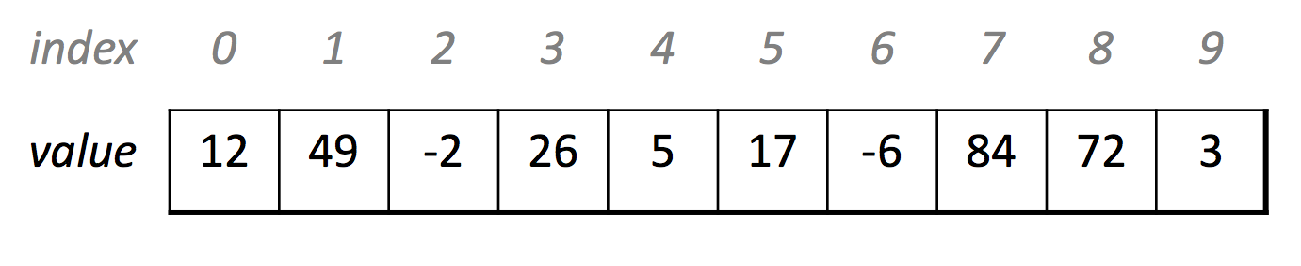
Previously…
An array is a variable type that represents a list of items.
You access individual items in an array by index.
Stores a single type of item (int, double, GRect, etc.)
intArray
int[] intArray = new int[5];
intArray[2] = 3;
0
0
3
0
0
0
int[] belowArray = {12, 49, -2, 26, 5, 17, -6, 84, 72, 3};
belowArray

Slide 3
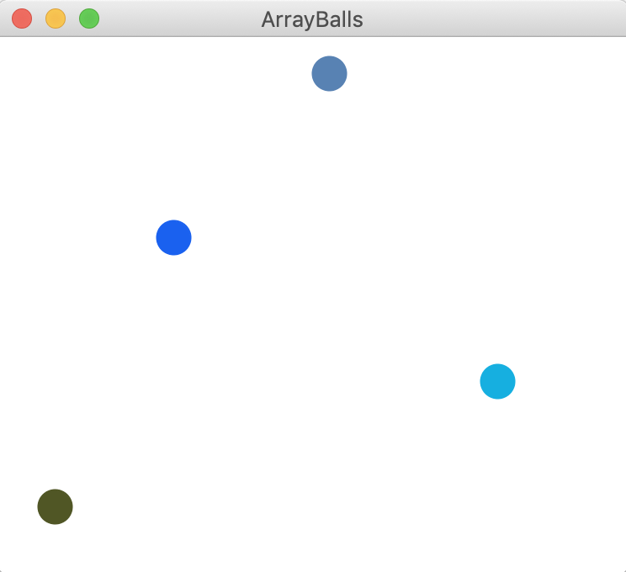
A quick warmup
How do we program the following:
4-element GOval (50x50) array
Random colors
Put in random place on canvas
GOval[] balls = new GOval[N_BALLS];
for(int i = 0; i < balls.length; i++) {
balls[i] = new GOval(BALL_SIZE, BALL_SIZE);
balls[i].setFilled(true);
balls[i].setColor(rgen.nextColor());
add(balls[i],
rgen.nextDouble(0, getWidth() - BALL_SIZE),
rgen.nextDouble(0, getHeight() - BALL_SIZE));
}
🤔
balls
private static final double BALL_SIZE = 20;
private static final int N_BALLS = 4;
private RandomGenerator rgen = RandomGenerator.getInstance();
public void run() {
GOval[] balls = new GOval[N_BALLS];
for(int i = 0; i < balls.length; i++) {
balls[i] = new GOval(BALL_SIZE, BALL_SIZE);
balls[i].setFilled(true);
balls[i].setColor(rgen.nextColor());
add(balls[i],
rgen.nextDouble(0, getWidth() - BALL_SIZE),
rgen.nextDouble(0, getHeight() - BALL_SIZE));
}
int[] intArray = new int[5];
intArray[2] = 3;
for(int i = 0; i < intArray.length; i++) {
println(intArray[i]);
}
}

Slide 4
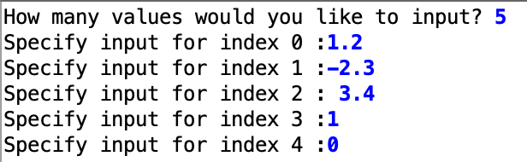
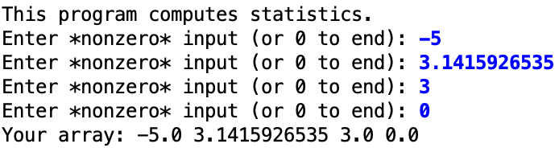
A Different User Experience
values
Your array program
5
1.2
-2.3
3.4
1
<empty>
index:
0
1
2
3
4
An ArrayList program
valuesArrayList
5
1.2
-2.3
<empty>
index:
0
1
2

Slide 5
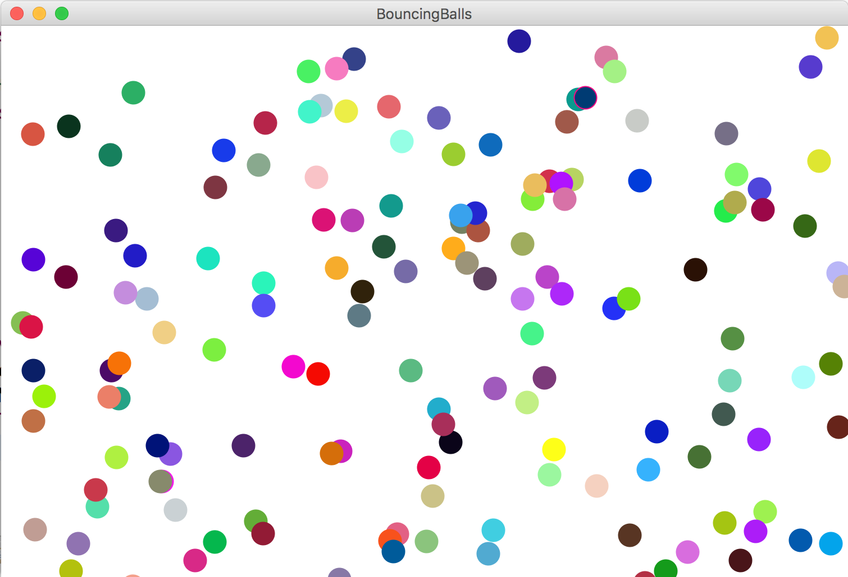
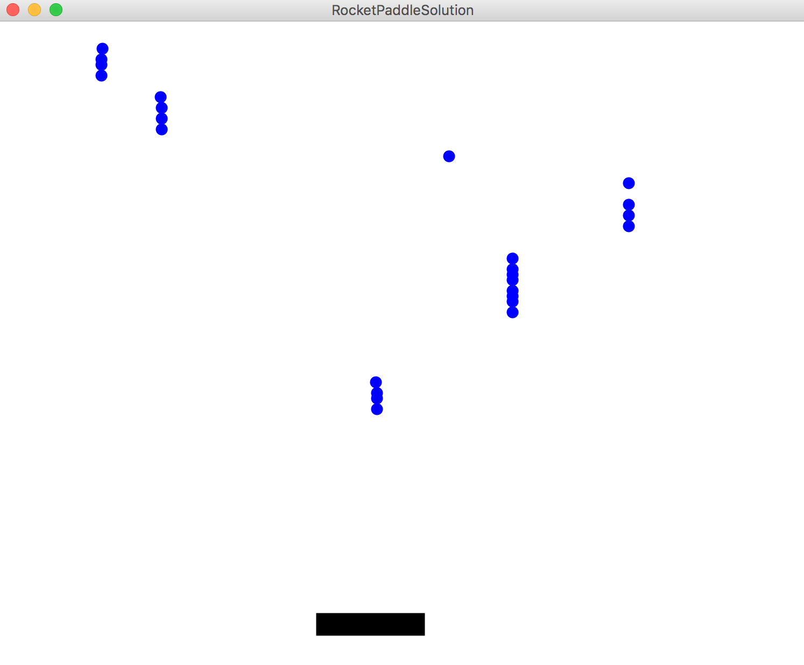
After This Lecture!

Slide 6
Meet ArrayLists
A variable type that represents a list of items.
You access individual items by index.
Store a single type of object (String, GRect, etc.)
Resizable – can add and remove elements
Has helpful methods for searching for items
Memnun oldum!

Slide 7
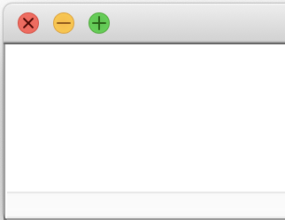
ArrayList
// Create an (initially empty) list
ArrayList <Integer> list = new ArrayList<Integer>();
// Add an element to the back
list.add(16); // now size 1
list.add(42); // now size 2
16
42
list
<empty>
index:
0
1

Slide 8
ArrayList
// Create an (initially empty) list
ArrayList <Integer> list = new ArrayList<Integer>();
// Add an element to the back
list.add(16); // now size 1
list.add(42); // now size 2
// Access elements by index (starting at 0!)
println(list.get(0)); // prints 16
println(list.get(1)); // prints 42
16
42
list
<empty>
16
index:
0
1
42

Slide 9
Looping over all elements
// Access elements by index (starting at 0!)
for (int i = 0; i < list.size(); i++) {
println(list.get(i));
}
16
42
27
18
6
22
list
<empty>
…
0
1
2
3
4
…
list.size()-1
index:

Slide 10
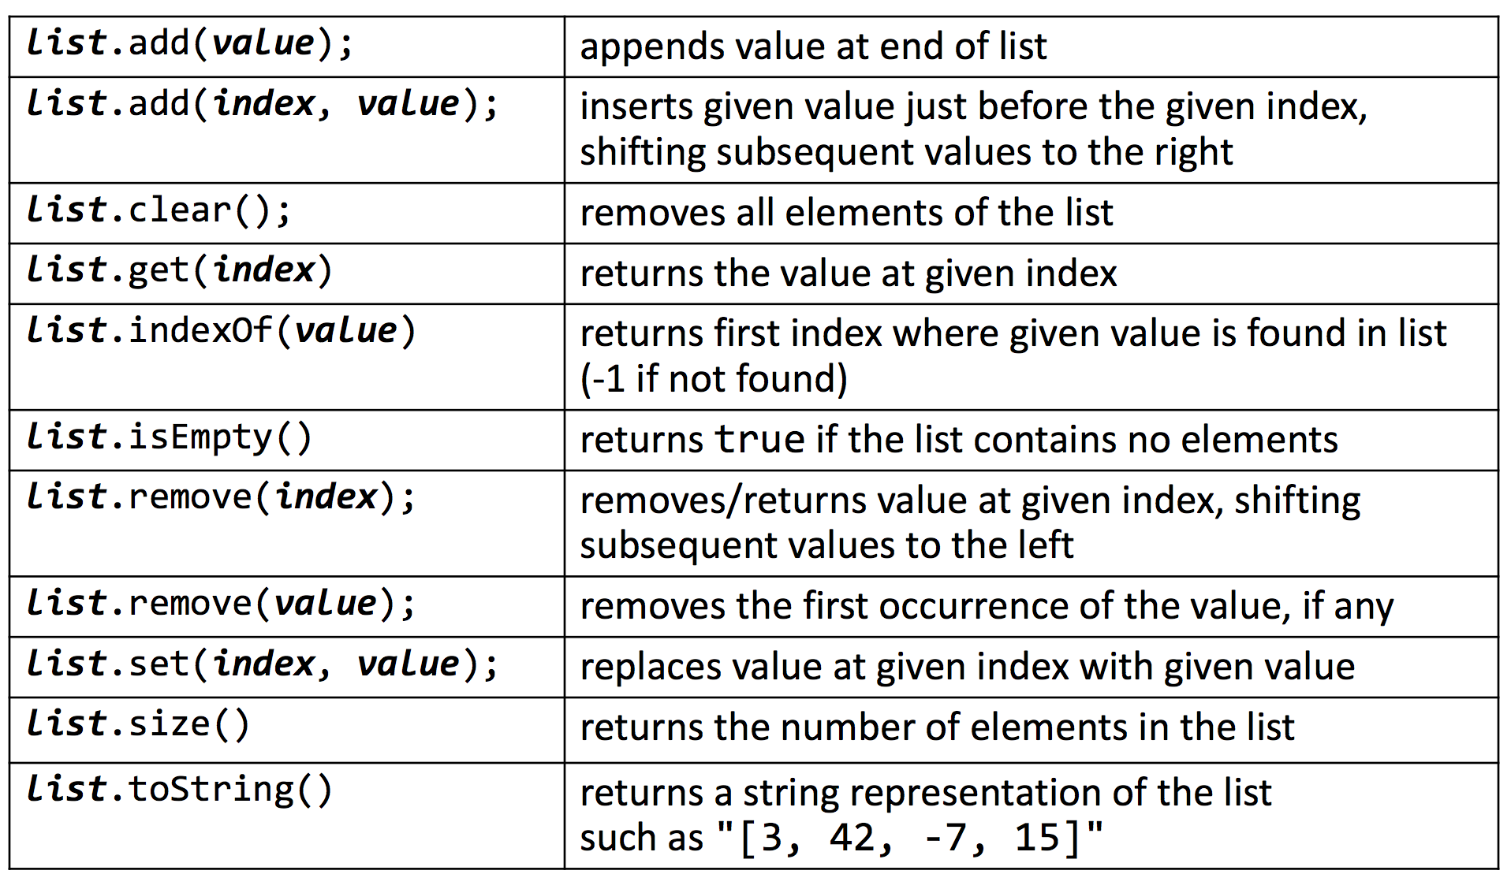
ArrayList Methods

Slide 11
Insert/Remove
list
16
42
27
Original ArrayList:
index:
0
1
2
If you insert/remove in the front or middle of a list, elements shift to fit.
Add element to end of list
list
16
42
27
18
list.add(18);
index:
0
1
2
3
Add element to middle of list
list
16
42
99
27
list.add(2,99);
index:
0
1
2
3
Remove element from front of list
list
42
27
int x = list.remove(0);
index:
0
1
🤔
x
16

Slide 12
Questions?

Slide 13
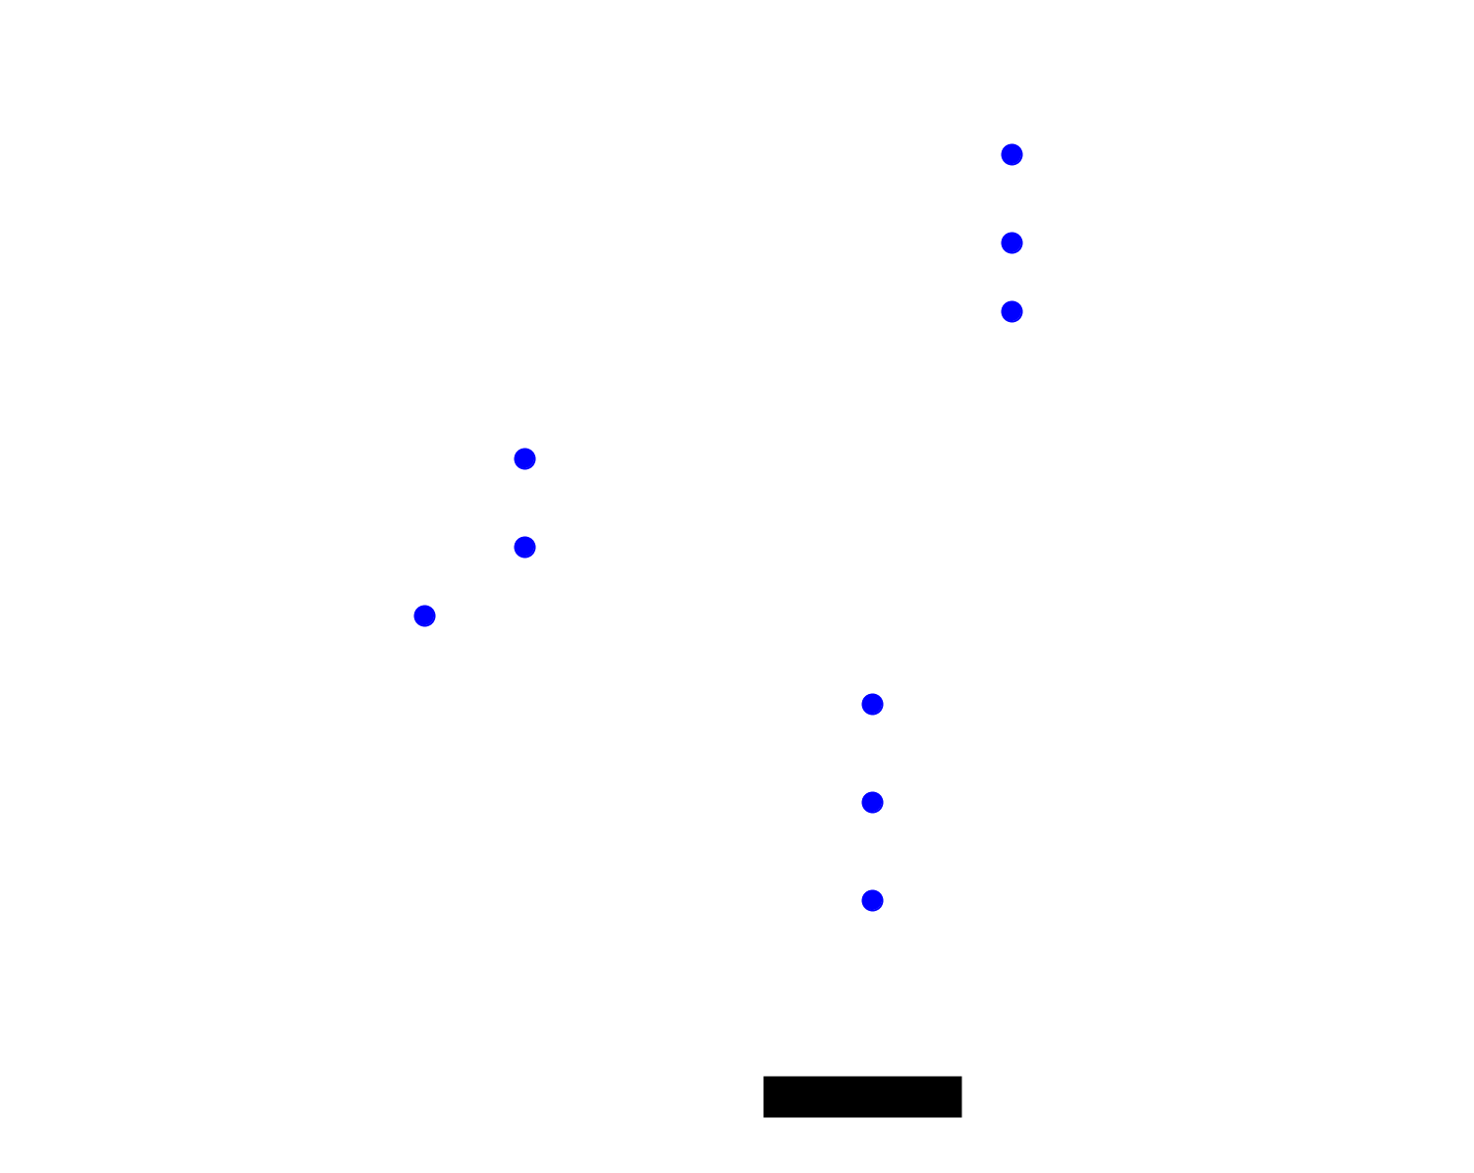
Rocket Paddle

Slide 14
Rocket Paddle
rocketList: the visible rockets on the canvas

Slide 15
Rocket Paddle
Java ArrayList library
import java.util.ArrayList;
public class RocketPaddle extends GraphicsProgram {
private ArrayList<GOval> rocketList;
private GRect paddle;
public void run() {
rocketList = new ArrayList<GOval>();
createPaddle();
addMouseListeners();
while(true) {
animateRockets();
pause(100);
}
}
...
}
Setup
Animate
rocketList: the visible rockets on the canvas

Slide 16
Interact
public void mousePressed(MouseEvent e) {
double x = e.getX();
double y = PADDLE_Y;
GOval rocket = new GOval(x, y, BALL_SIZE, BALL_SIZE);
...
add(rocket); // add the rocket to the screen
rocketList.add(rocket); // add the rocket to the list
}
Animate
private void animateRockets() {
// loop over list backwards so that we can
// safely remove from the list.
for(int i = rocketList.size() - 1; i >= 0; i--) {
GOval rocket = ?????? // get the rocket
?????? // move the rocket
// remove the rocket
??????
}
}
rocketList: the visible rockets on the canvas

Slide 17


ArrayLists and Primitives
// Doesn’t compile ☹
ArrayList <int> list = new ArrayList<int>();
Syntax error, insert “Dimensions” to complete ReferenceType
2x
double
Unlike arrays, ArrayLists can
only store objects.
GRect
boolean
GOval
int
String
char

Slide 18
ArrayLists and Primitives
// Doesn’t compile ☹
ArrayList <int> list = new ArrayList<int>();
Syntax error, insert “Dimensions” to complete ReferenceType
2x
Primitive | “Wrapper” Class
int | Integer
double | Double
boolean | Boolean
char | Character
Unlike arrays, ArrayLists can
only store objects.
Objects: GRect, GOval, String, etc.

Slide 19
ArrayLists and Primitives
// Doesn’t compile ☹
ArrayList <int> list = new ArrayList<int>();
// Use wrapper classes when making an ArrayList
ArrayList <Integer> list = new ArrayList<Integer>();
// Java converts Integer <-> int automatically!
int num = 123;
list.add(num);
int first = list.get(0); // 123

Slide 20
ArrayLists vs. Arrays
ArrayLists
Arrays
(+) Can add/remove elements
(–) Needs wrapper class for primitives
(+/–) Fixed size
(+) Simpler syntax
(+) Multi-dimensional arrays! (images)
Good for:
Good for:
Lists updated through user interaction
Constant list for lookup
Updating a grid
Why do both of these exist in the Java language?
Arrays are Java’s fundamental data storage
ArrayList is a library built on top of an array

Slide 21
Questions?

Slide 22
Bouncing Balls
🤔
Implementation ideas for Final Project!
(example) BouncingBalls.java

Slide 23
Bouncing Balls
Each Ball:
GOval
ballVx
ballVy
(1) Setup
(2) Animate
// for the i-th ball
GOval ball = balls.get(i);
// update i-th vx/vy
// (perform wall bounce)
// move ball
ball.move(ballsVx.get(i), ballsVx.get(i));
balls
ballsVx
1.7
-4.1
-5.0
6.5
ballsVy
-3.2
2.1
4.5
-6.9
index:
0
1
2
3

Slide 24
Your Final Project is like İskender
Excellent, existing ideas
Some basics
Think outside the box
Your projects, worked examples

Slide 25
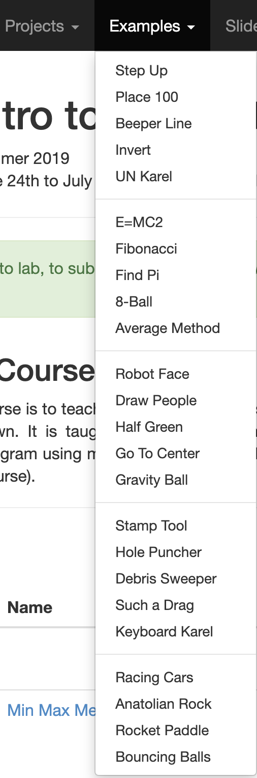
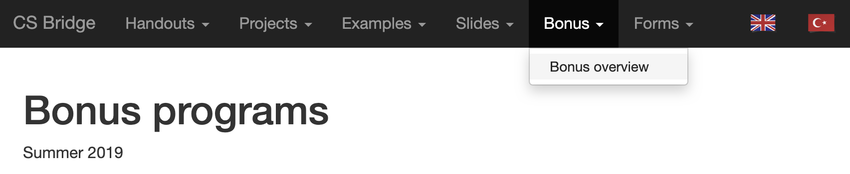
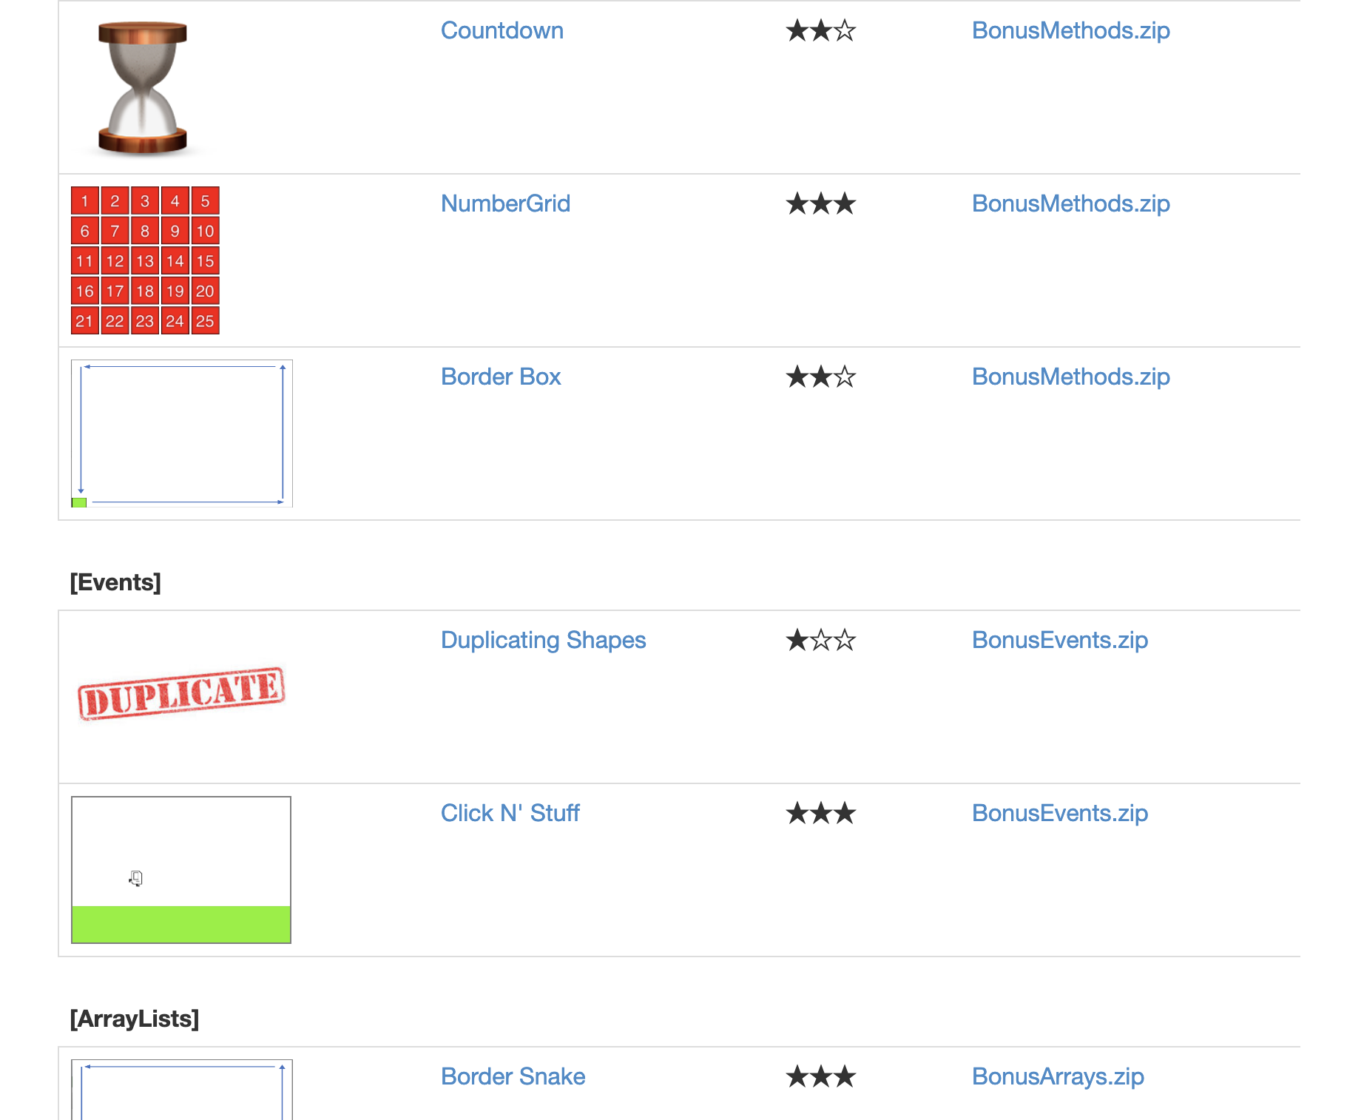
Lots of Help

Slide 26

Lots of Help

Slide 27
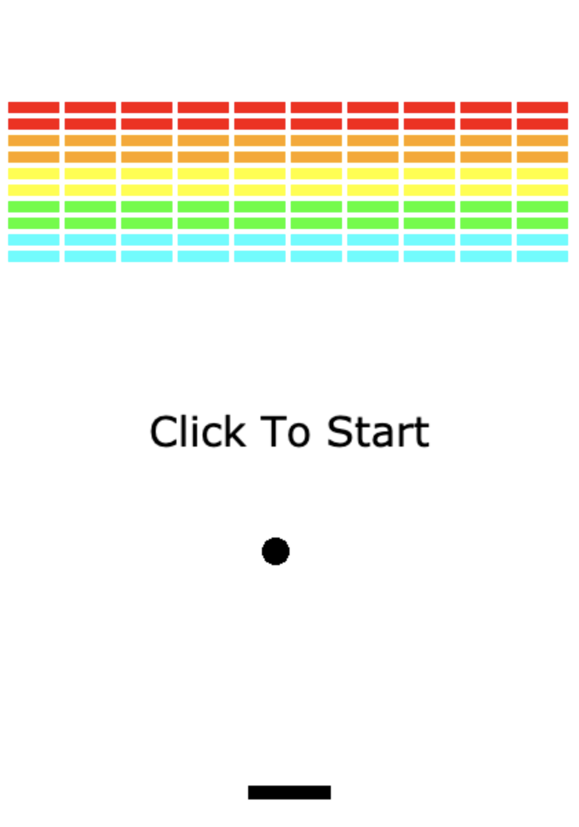
Your goals today
(2) Array exercise: MinMaxMean (+ ArrayList exercises) for tomorrow
(3) Get Final Project idea approved
Console/Graphics,
Games/Stories,
Puzzles/Adventures,
Math/Medicine/Science,
…The ArrayList goes on!
(1) Breakout: Finish it up!

